Slide 1
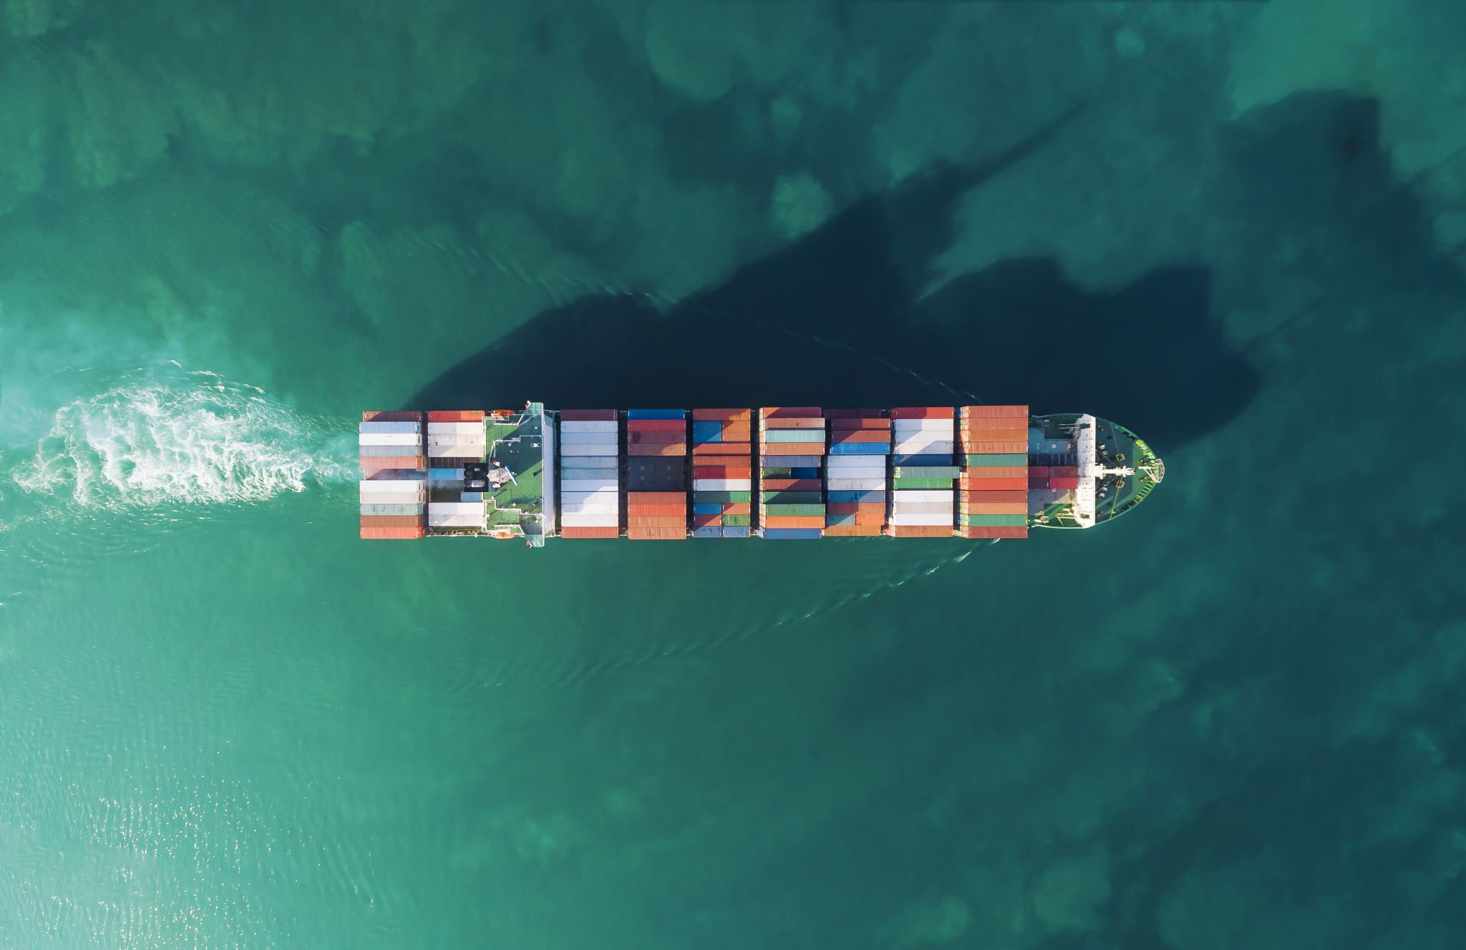
Visualizing U.S. Container Trade by Ports
An Analysis of Maritime Container Volumes from 2000-2017
Andre Seen

Slide 2
Problem Statement & Significance
Research Question: "How have container trade volumes changed across different U.S. ports from 2000 to 2017?"
Economic Impact
Ports are critical for international trade, with billions of dollars in cargo being handled every year
Policy Development
Guides economic and trade policies at federal, state, and local levels
Infrastructure Planning
Find out which ports are operating at full capacity, which ports are growing rapidly, and which need investment for future growth
Logistics Optimization
Find trade patterns and trends that help improve shipping routes

Slide 3
Dataset Overview
Source
Opendatabay Data Marketplace – Historical US Maritime Container Trade Volumes
Time Period
2000–2017 — 18 years of continuous data
Coverage
63 U.S. Ports — All major coastal regions included
Measurement Unit
TEUs (Twenty-foot Equivalent Units)
Dataset Characteristics
Format: CSV file
Data Types: Numerical & Categorical
Analysis: Geographic & Temporal

Slide 4
Data Preparation & Cleaning
Remove Commas from Numbers
The dataset used numbers with commas such as ("27,282,529") that needed to be removed for further analysis.
Convert to Numeric Format
Converted all volume data from text strings to numeric data type for calculations.
Handle Missing Values
Found and removed rows with missing or invalid data to ensure data accuracy.
Restructure Data Format
Transformed data from wide format to long format for time-series analysis.

Slide 5
Visualization Strategy
Interactive Line Chart
Purpose: Track temporal trends for the top 5 ports over 18 years
Answers: How have the largest ports grown over time? What impact did recession have?
Shows: Volume changes by year with interactive hover features
Bar Chart
Purpose: Compare the top 10 ports in the most recent year of the dataset (2017)
Answers: Which ports handle the most container volume in 2017?
Shows: Clear ranking of ports by current volume
Heatmap
Purpose: Display volume intensity across 18 for all 63 ports
Answers: When did major changes occur? Are there patterns across multiple ports?
Shows: Color-coded legend where lighter colors show higher volumes
Scatter Plot
Purpose: Analyze the relationship between growth rate and average volume for the top 10 ports
Answers: Which ports are growing fastest? Are large ports still growing or stable?
Shows: Each port is plotted by both its size and growth
Stacked Area Chart
Purpose: Show each port's contribution to total U.S. container trade
Answers: How much does each port contribute to U.S. trade?
Shows: Contributions over time with cumulative totals

Slide 6
Tools & Technologies
Development Environment
• Jupyter Notebook
• Python 3
Visualization Libraries
• Matplotlib — Static visualizations and charts
• Seaborn — Statistical data visualizations
• Plotly — Interactive visualizations
Design Techniques
• Color coding for clarity
• Interactive visualization for in-depth analysis
• Clear legends and labels
Data Processing
• Pandas
• NumPy

Slide 7
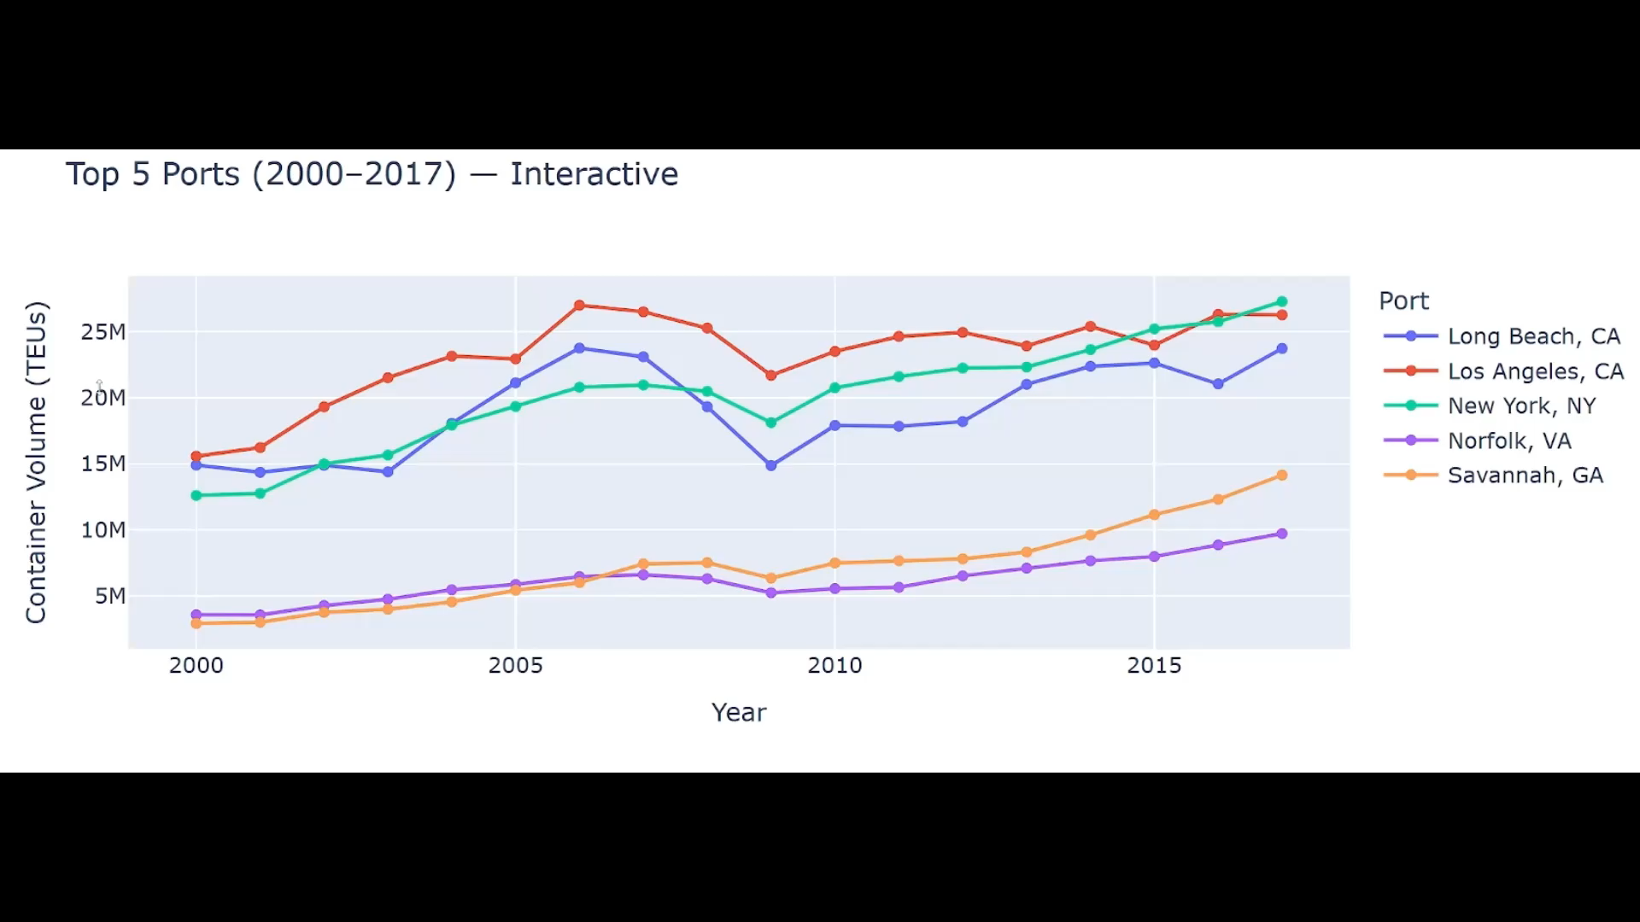
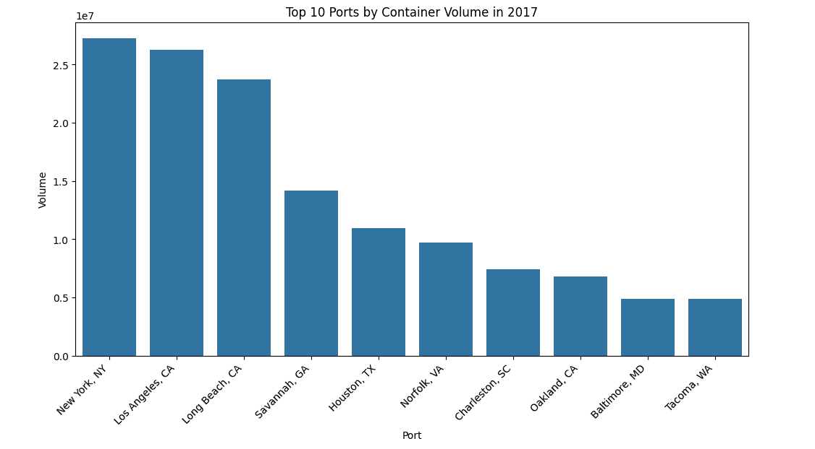
Temporal & Comparative Analysis
Interactive Line Chart
What It Shows:
Top 5 ports ranked by average container volume from 2000 to 2017.
Interactive Features:
• Hover over data points for exact volume
• Toggle ports on/off for specific comparisons
Key Insights:
• Los Angeles and Long Beach handle the majority of West Coast trade
• New York is the top port in volume
• Clear volume drop during 2008–2009 recession
• Strong recovery and growth from 2010–2017
Bar Chart
What It Shows:
Top 10 U.S. ports ranked by container volume in 2017
(most recent year).
Features:
• Clear visual comparison of current rankings
• Volumes formatted in millions (M) for readability
• Clear on who are the leaders in terms of volume
Key Insights:
• New York surpassed Los Angeles to become #1 by 2017
• Top 3 ports handle significantly more volume than others
• Savannah has grown a lot to become 4th largest port
• Clear gap between major ports and smaller regional ports

Slide 8
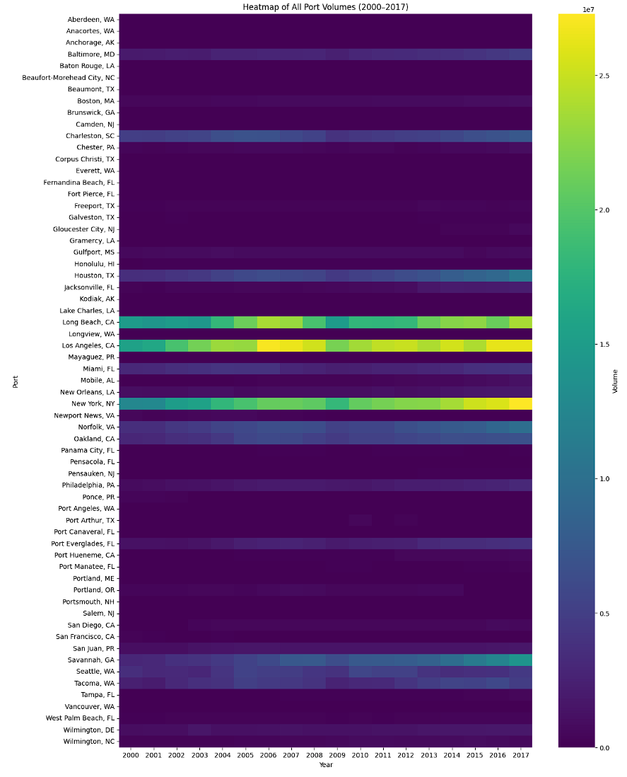
Heatmap: Pattern Recognition
What It Shows:
Volume intensity for all 63 ports across 18 years (2000-2017).
How to Read It:
• Rows represent ports; Columns represent years
• Lighter colors = higher volume
• Darker colors = lower volume
Key Insights:
• 2008–2009 recession visible as darker colors show in every port
• Steady growth shown via progressively lighter colors
• LA and Long Beach show consistently light colors
• Savannah shows change from dark to light meaning rapid growth

Slide 9
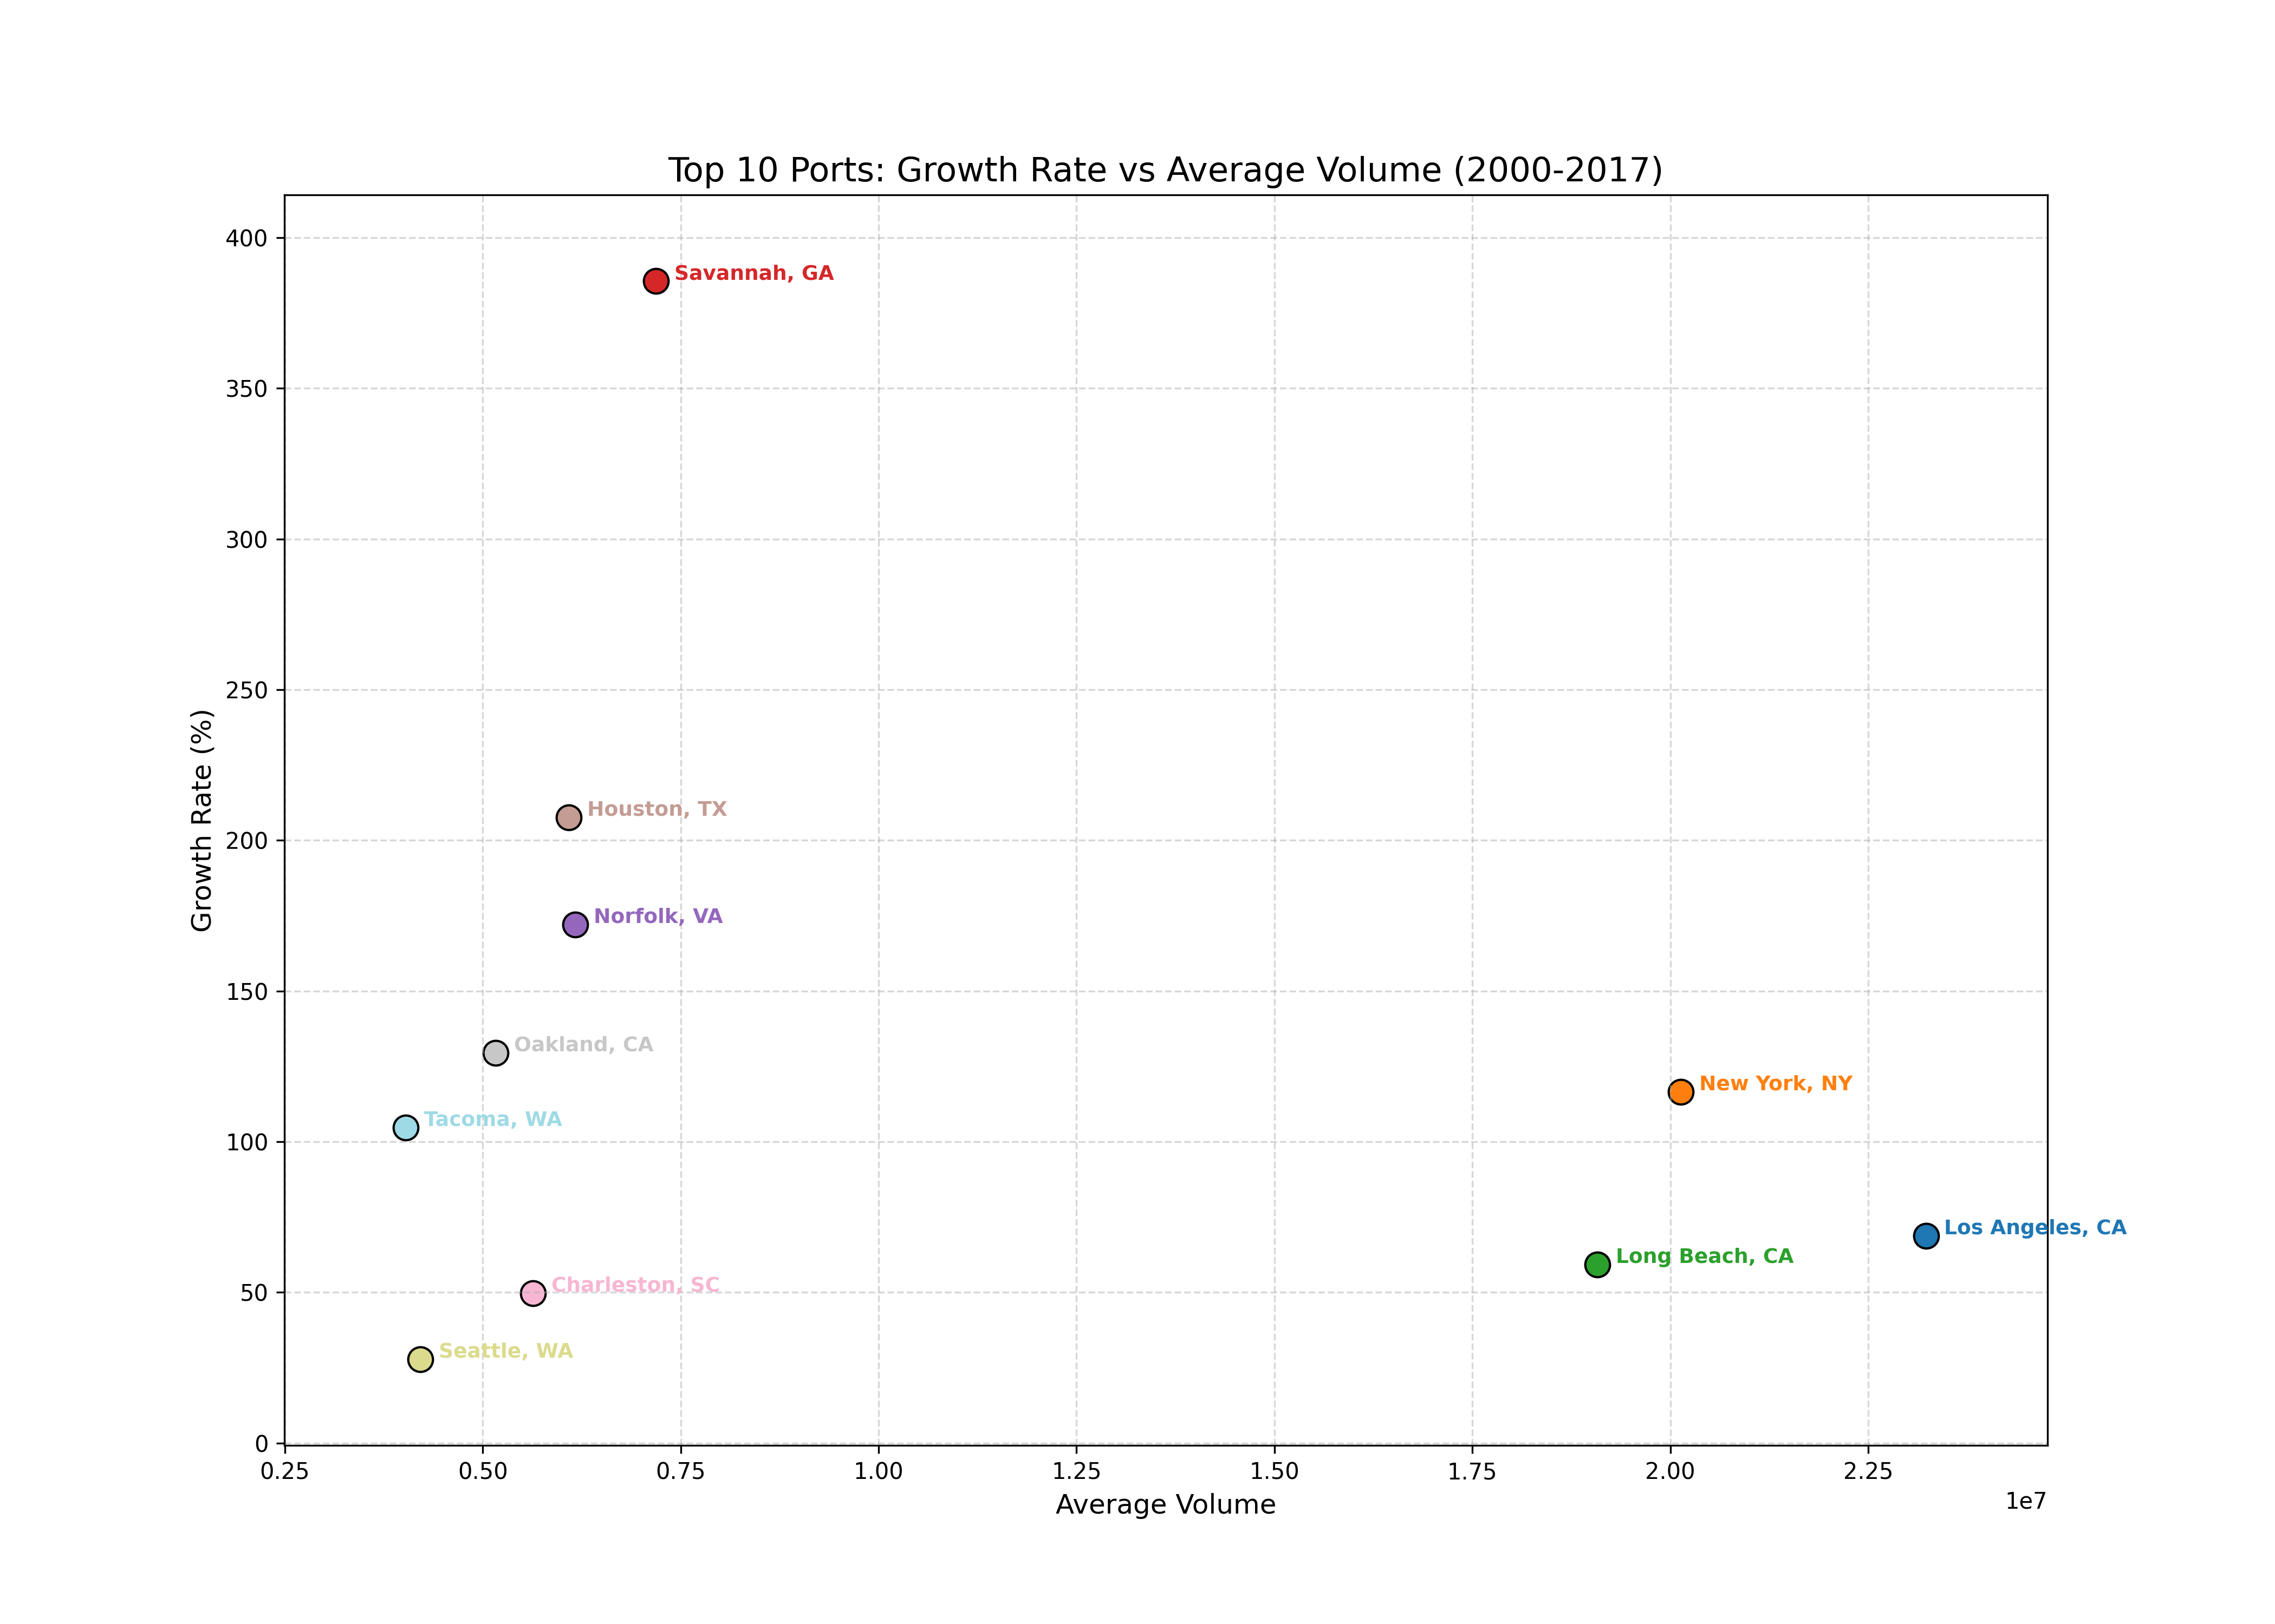
Scatter Plot: Growth Analysis
What It Shows:
Growth rate (percentage change) plotted against average volume for top 10 ports.
How to Read It:
• X-axis: Average container volume (right = larger)
• Y-axis: Growth rate 2000-2017 (up = faster growing)
• Each point represents one labeled port
Key Insights:
• Savannah & Houston show high growth
• LA & Long Beach have high volume but low growth
• Expansion vs. steady operation ports
• High-growth ports would need more investment

Slide 10
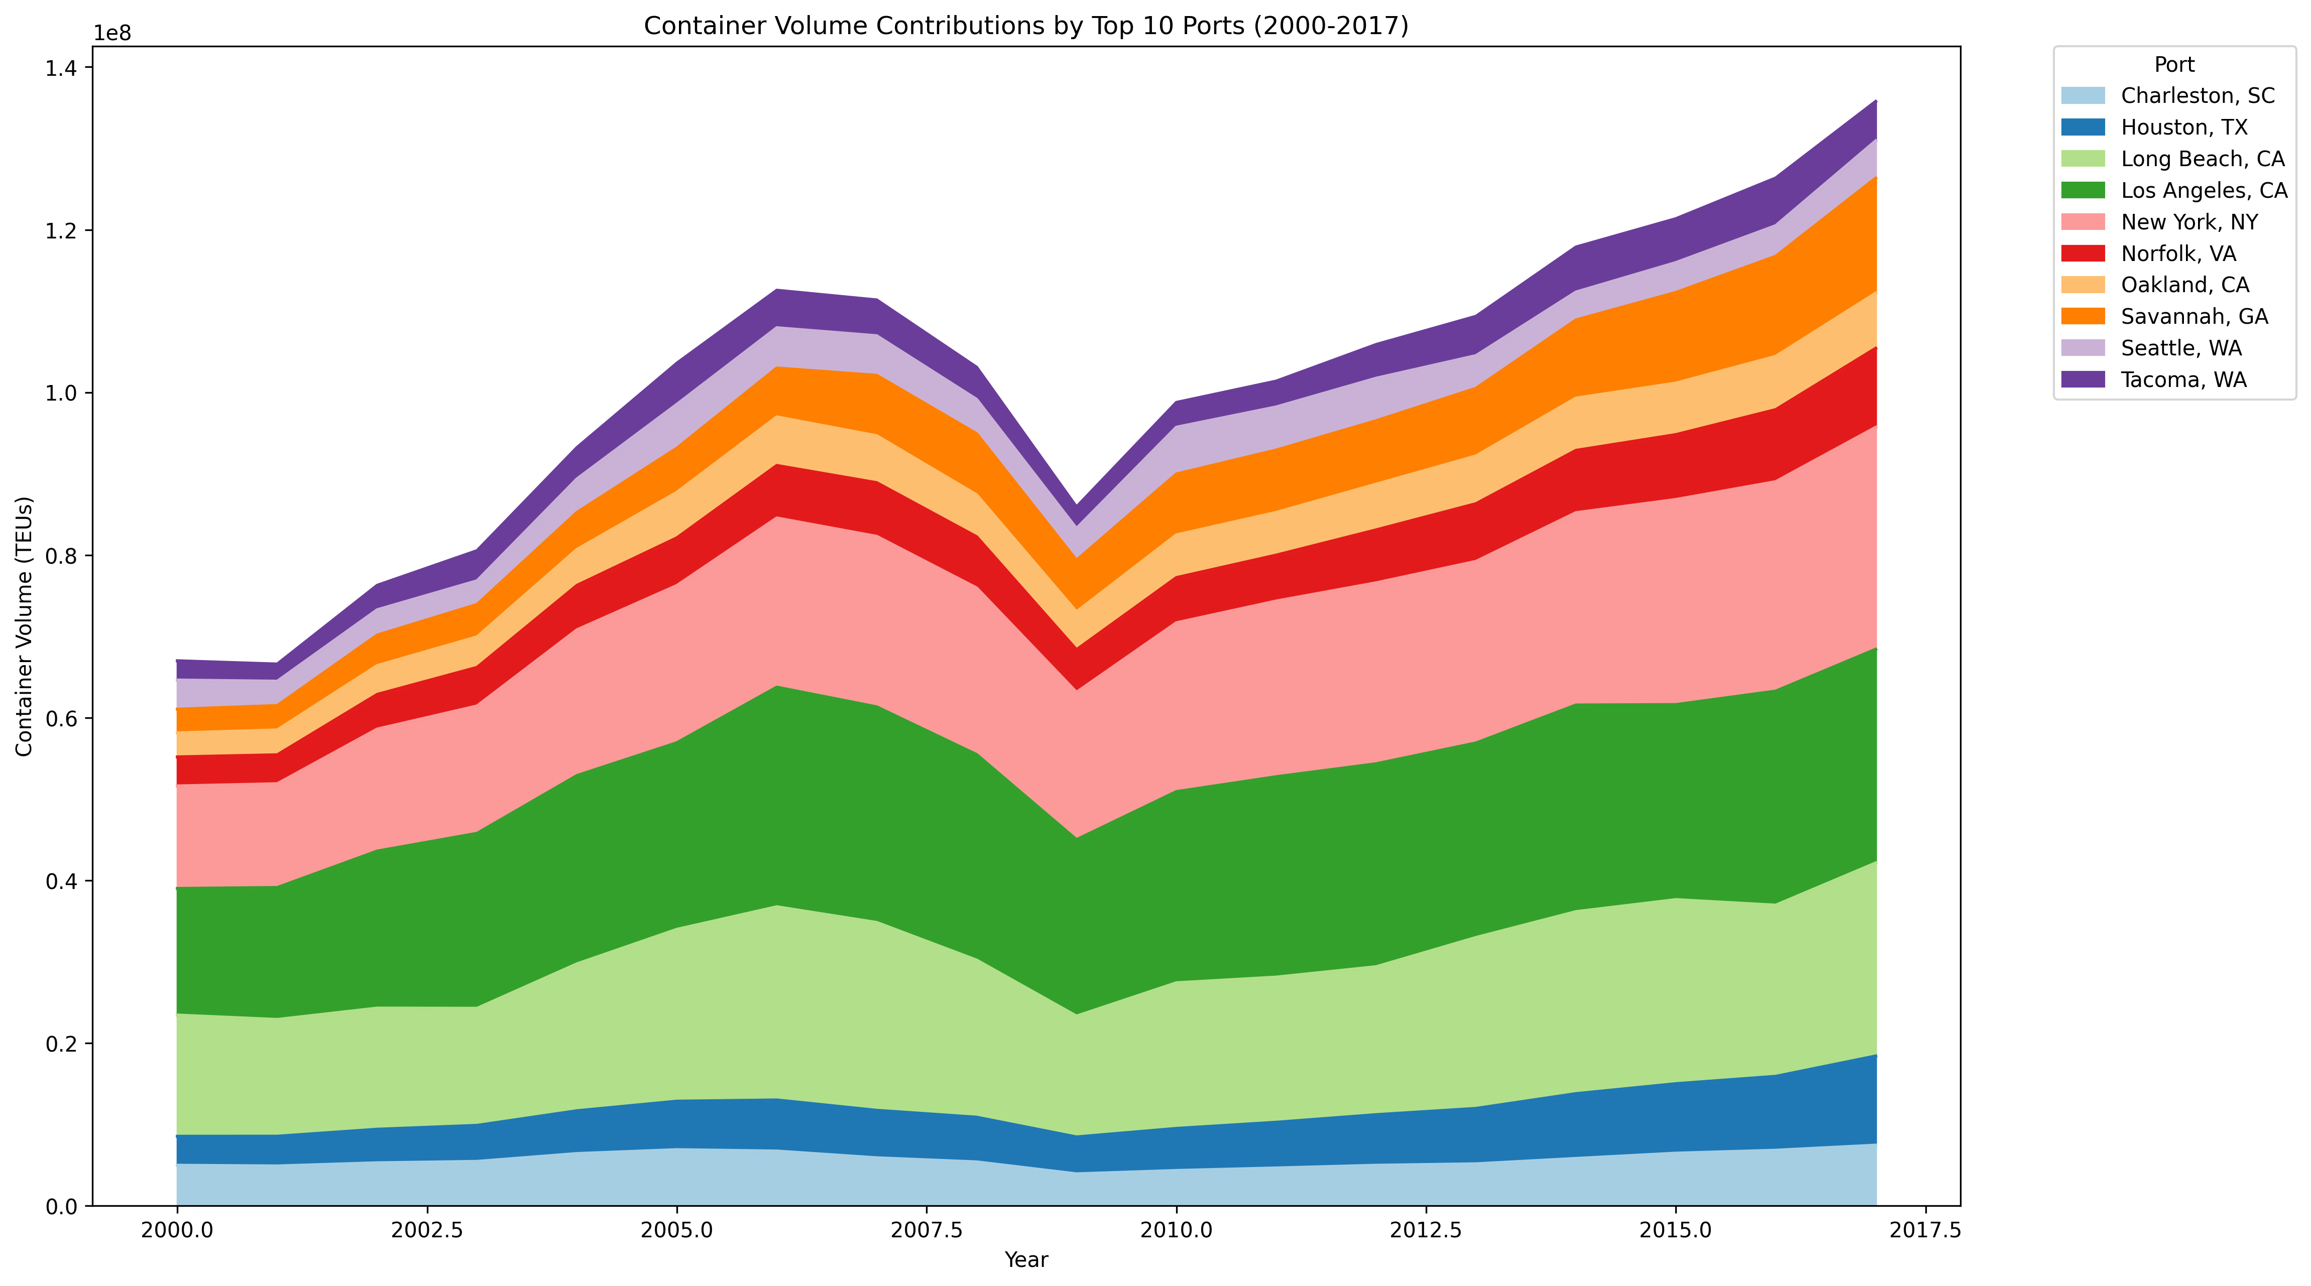
Stacked Area Chart: Contribution Analysis
What It Shows:
Each port's contribution to total U.S. container trade volume over time (2000–2017).
How to Read It:
• Total height shows combined volume of all top 10 ports
• Layer thickness indicates individual port's contribution
• Color-coded legend on the right which labels different ports
Key Insights:
• West Coast ports dominate volume contributions
• East Coast ports steadily gaining market share
• U.S. container trade has doubled from 2000–2017

Slide 11
Key Findings Summary
1
Dominant Ports
• Los Angeles, Long Beach, and New York handle around 50% of all U.S. container trade combined.
2
Recession Impact
• The 2008–2009 financial crisis caused significant volume drops across all major ports, with recovery taking 2–3 years.
3
Emerging Leaders
• Savannah and Houston show the highest growth rates, showing possible infrastructure development in the near future.
4
Overall Growth
• Total U.S. container trade volume increased by over 100% from 2000 to 2017, showing the importance of maritime trade to the U.S. economy.

Slide 12
Real-World Applications
Logistics & Supply Chain Planning
• Improve shipping routes based on the capacity of each port
• Identify alternative ports during congestion or disruptions
• Plan warehouse locations near high-volume ports
Supply Chain Risk Management
• Spread shipments to different ports to avoid congestion
• Understand that some West Coast ports handle a lot of traffic.
• Find out how well ports can handle issues during economic hardship
Infrastructure Investment Decisions
• Focus on funding ports that show rapid growth
• Identify ports needing expansion before congestion
• Plan highway, railway, and facility improvements to support growth
Economic Policy & Trade Analysis
• Use port data to make trade policy decisions
• Predict trade patterns in the future from past data
• Find out how maritime trade affects economic growth in the region

Slide 13
References
1
• FREE DATASET LIBRARY. (n.d.). Historical US Maritime Container Trade Volumes [Data set]. Opendatabay Data Marketplace. CC0 Public Domain. Retrieved November 4, 2025, from https://www.opendatabay.com/dataset/historical-us-maritime-container-trade-volumes

